Slide 1
Scam Detection + Prank Virus
By: Lanz Dungo, Matthew Wolz, Umair Iqbal

Slide 2

Spam Email Classification Using Machine Learning
Goal:
Predict whether an email is spam or not spam using text-based features
Dataset:
Two columns:
Label (0 = not spam, 1 = spam)
Text
Approach:
Feature Engineer text-based signals
Feed into a Random Forest
Feature Explanations
Question: What features contribute most to whether a email is spam or not?

Slide 3
Engineered Features & Model Used
Extracted:
Keyword indicators
“Free” → has_free
“Cash” → has_cash
“Link” → has_link
“Urgent” → has_urgent
Structure variables
Word count → num_words
Question marks →num_questions
Sentiment polarity
Trained a Random Forest Classifier (92% accuracy)
Optuna hyperparameter tuning
Spam Label | Number of Words | Contains "Free"
0 | 20 | 0
0 | 6 | 0
1 | 28 | 1
0 | 11 | 0
0 | 13 | 0
1 | 32 | 0
0 | 16 | 0
0 | 26 | 0
1 | 26 | 0
1 | 29 | 1
Note: the full dataset has 21 columns

Slide 4
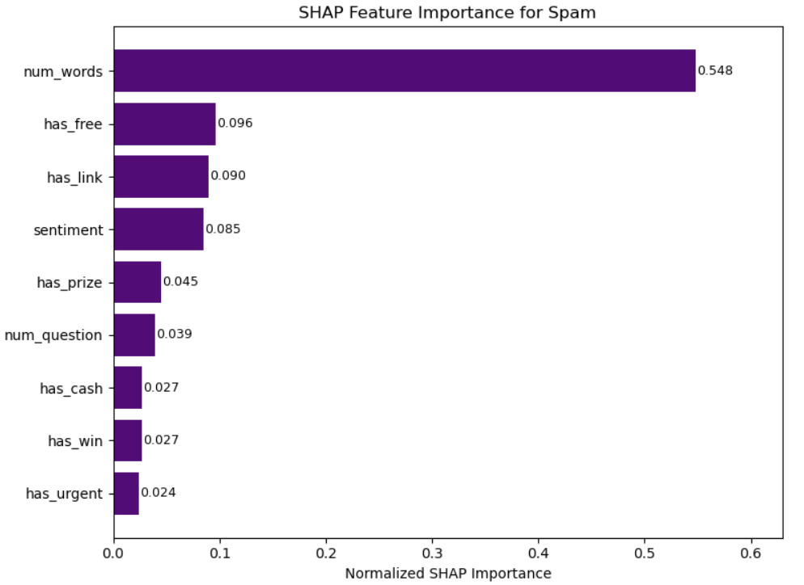
What Predicts Spam?
SHAP values:
Feature ranking
Importance values
What variables does the model deem as important?
num_words (~55%)
has_free
has_link
sentiment
SHAP values → what signals do the model consider “spam-like”?

Slide 5
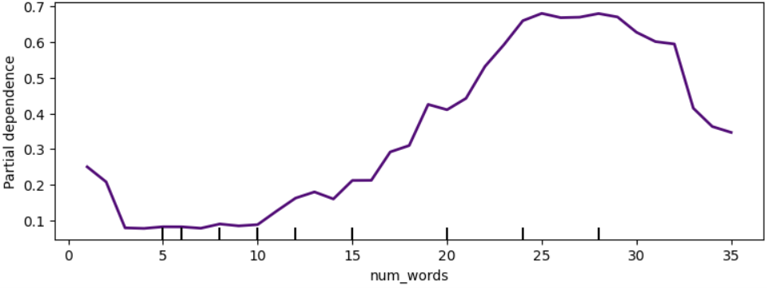
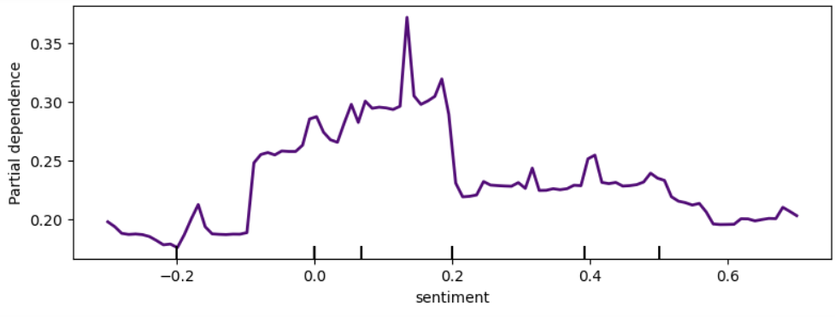
How Features Affect Spam Probability
Partial Dependence Plots (PDPs)
Show how changing a single feature impacts spam probability
num_words
Spam probability rises sharply after ~15-20 words in length
Sentiment
Neutral/slightly positive sentiment increases spam likelihood

Slide 6

Key Takeaways
Spam emails often
Are longer
Contain promotional keywords (“free”, “link”, “prize”, “winner”)
Use upbeat/positive sentiment
The random forest model achieves strong performance
92% overall accuracy
Explainable by SHAP values + PDPs
Leads to better knowledge of what a spam email contains

